Slide 1
AWS GDI
Using Grand Central and AWS to get data into Splunk
Splunk Cloud Bootcamp
July-20

Slide 2
Agenda
Setting up AWS and use Grand Central to GDI
Setup HEC on Splunk Cloud Deployment
CloudTrail, Config, VPCFlow Logs
AWS Setup
Create AWS Account
Setup VPC Flow Logs
Setup Grand Central (Local deployment)
Configure Grand Central
Deploy Data Collection
Delete Deployments

Slide 3
Open a Text Editor
Make a note of these variables
Splunk Variables
HEC Token (CloudTrail)
HEC Token (VPCFlow Logs)
HEC Token (Config)
HEC Endpoint | https://http-inputs-firehose-mystack.splunkcloud.com:443
AWS Variables
IAM Access Key
IAM Secret Key
CloudWatch Log Group

Slide 4
Splunk HEC Setup
Adding HEC Endpoints

Slide 5
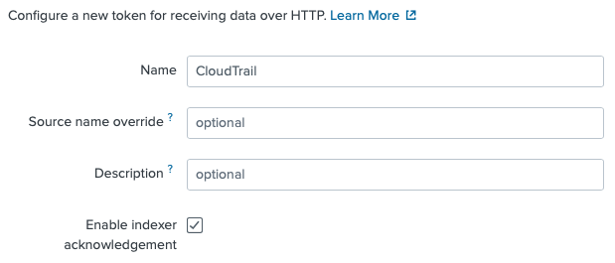
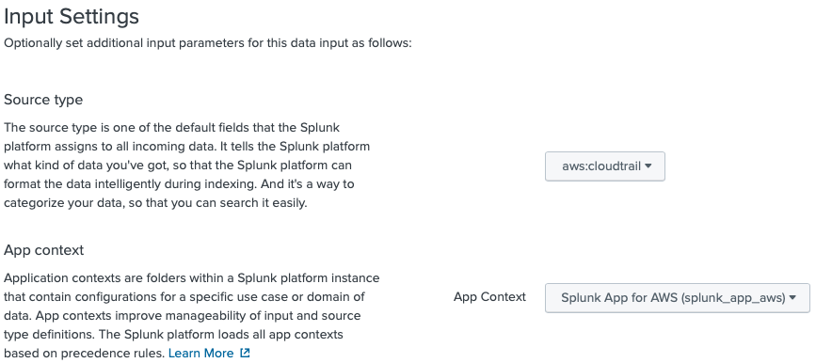
Setup HEC on Splunk Cloud Deployment
Setup CloudTrail HEC
Log into your stack and go to Settings -> Data Inputs -> HTTP Event Collector -> Add New
Step 1
Name = CloudTrail
Enable Indexer ACK = checked
Step 2
sourcetype = aws:cloudtrail
App Context = Splunk App for AWS
index=main (default)
Step 3
Submit and copy HEC Token
Copy to cheat sheet

Slide 6
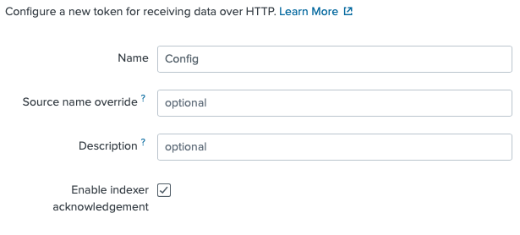
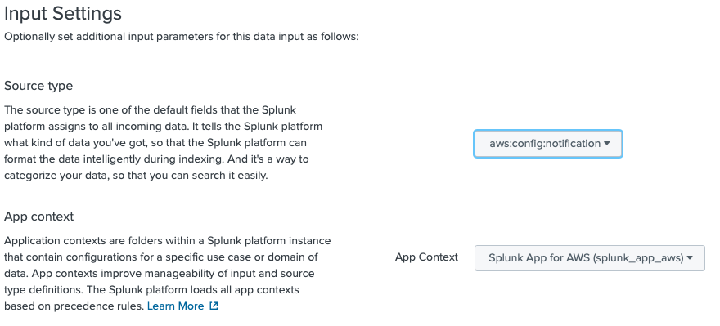
Setup HEC on Splunk Cloud Deployment
Setup Config HEC
Log into your stack and go to Settings -> Data Inputs -> HTTP Event Collector -> Add New
Step 1
Name = Config
Enable Indexer ACK = checked
Step 2
sourcetype = aws:config:notification
App Context = Splunk App for AWS
index=main (default)
Step 3
Submit and copy HEC Token
Copy to cheat sheet

Slide 7
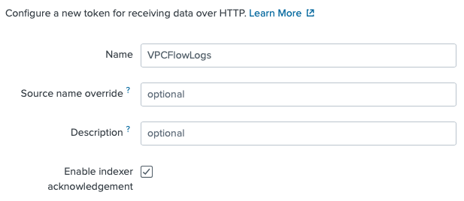
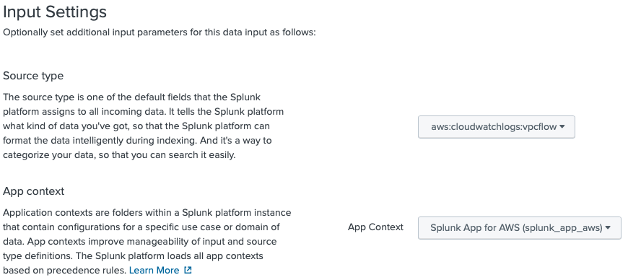
Setup HEC on Splunk Cloud Deployment
Setup VPCFlowLogs HEC
Log into your stack and go to Settings -> Data Inputs -> HTTP Event Collector -> Add New
Step 1
Name = VPCFlowlogs
Enable Indexer ACK = checked
Step 2
sourcetype = aws:cloudwatchlogs:vpcflow
App Context = Splunk App for AWS
index=main (default)
Step 3
Submit and copy HEC Token
Copy to cheat sheet

Slide 8
AWS Setup
Configure IAM Account and VPCFlow Logs

Slide 9
Create AWS Account
Generate Credentials File

Slide 10
Create AWS Account (Credential File)
Log into your AWS Console
Create IAM Policy
Create IAM User and attach policy
Download Credentials (credentials.csv)

Slide 11
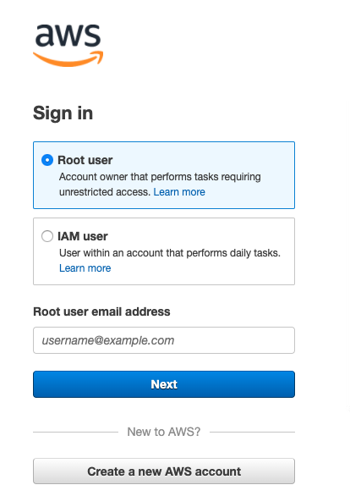
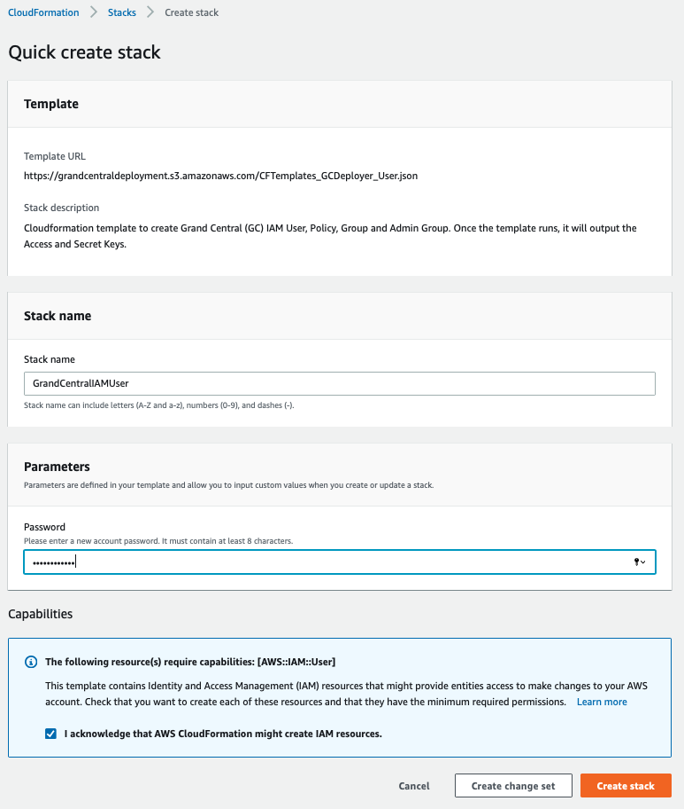
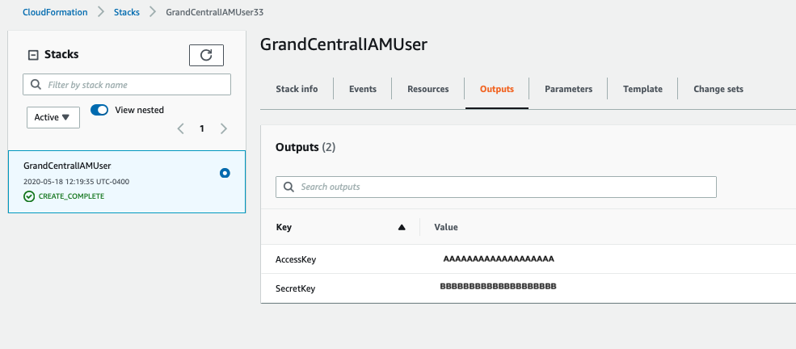
Shortcut IAM Creation
Three Step process
Log into your AWS Account
Click this link for cloudformation template to create user.
Store Credentials for next section
Copy to cheat sheet
** See Long Form section in Appendix for step-by-step process to create IAM and Policy.

Slide 12
CloudWatch Logs Collection
This will require you to setup CloudWatch Logs and VPC Flow log collection in your account.

Slide 13
Setup AWS to send CloudWatch Log
Overview
Create CloudWatch Log Group
Setup VPCFlow Logs
Send VPCFlow Logs to CloudWatch Log group (vpcflowlogs)
Setup policy that allows VPC to write to CW Logs

Slide 14
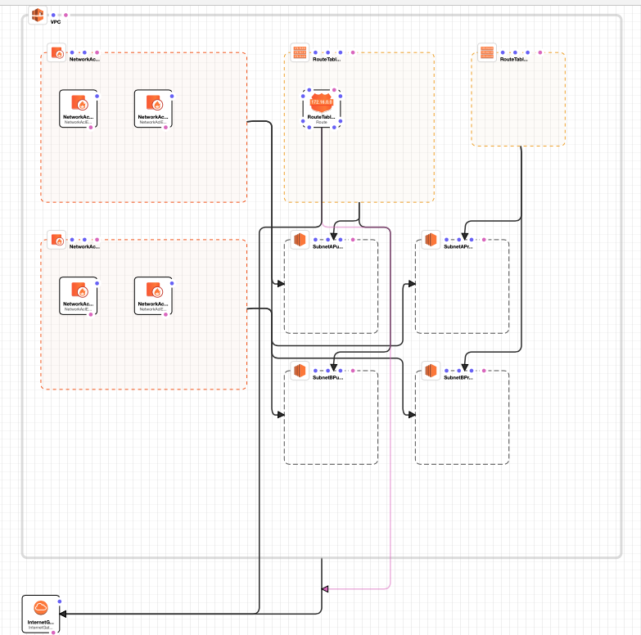
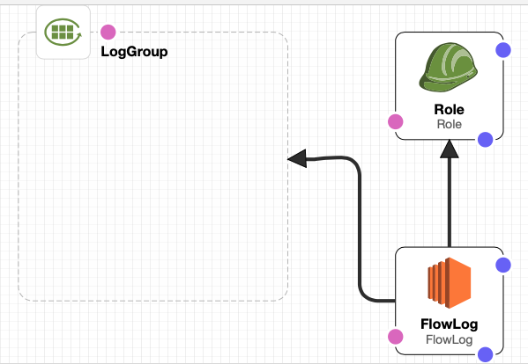
Shortcut Creating VPC & VPC Flow Logs **
Use these Cloudformation templates*
Click Step 1 – VPC Creation (3 minutes)
Basic VPC created with Class B network address
Click Step 2 – Create Flow Logs (2 minutes)
Check the “I acknowledge ..” Message
Creates Flow Logs Group
Creates Flow Logs IAM Role
* Source : https://templates.cloudonaut.io/en/v3.2.1/vpc/#vpc-flow-logs-to-cloudwatch-logs
** Long form in the appendix of this deck

Slide 15
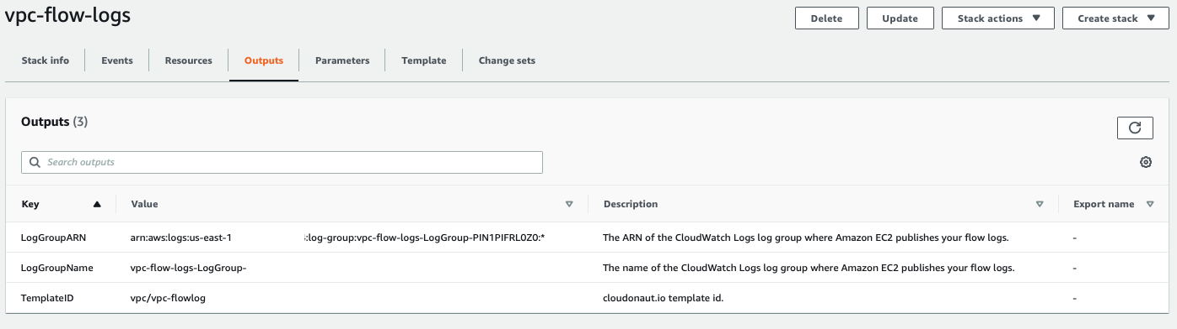
CloudWatch Log output
Outputs tab from the CloudFormation Template “vpc-flow-logs”
Copy to cheat sheet

Slide 16
Setup Grand Central

Slide 17
Setup Grand Central
If running locally on laptop, follow these steps:
Go to https://grandcentraldeployments.s3.amazonaws.com/grand_central_300.spl and download Grand Central.
Here is a link to the docs : https://github.com/amiracle/grand_central

Slide 18
Configure Grand Central

Slide 19
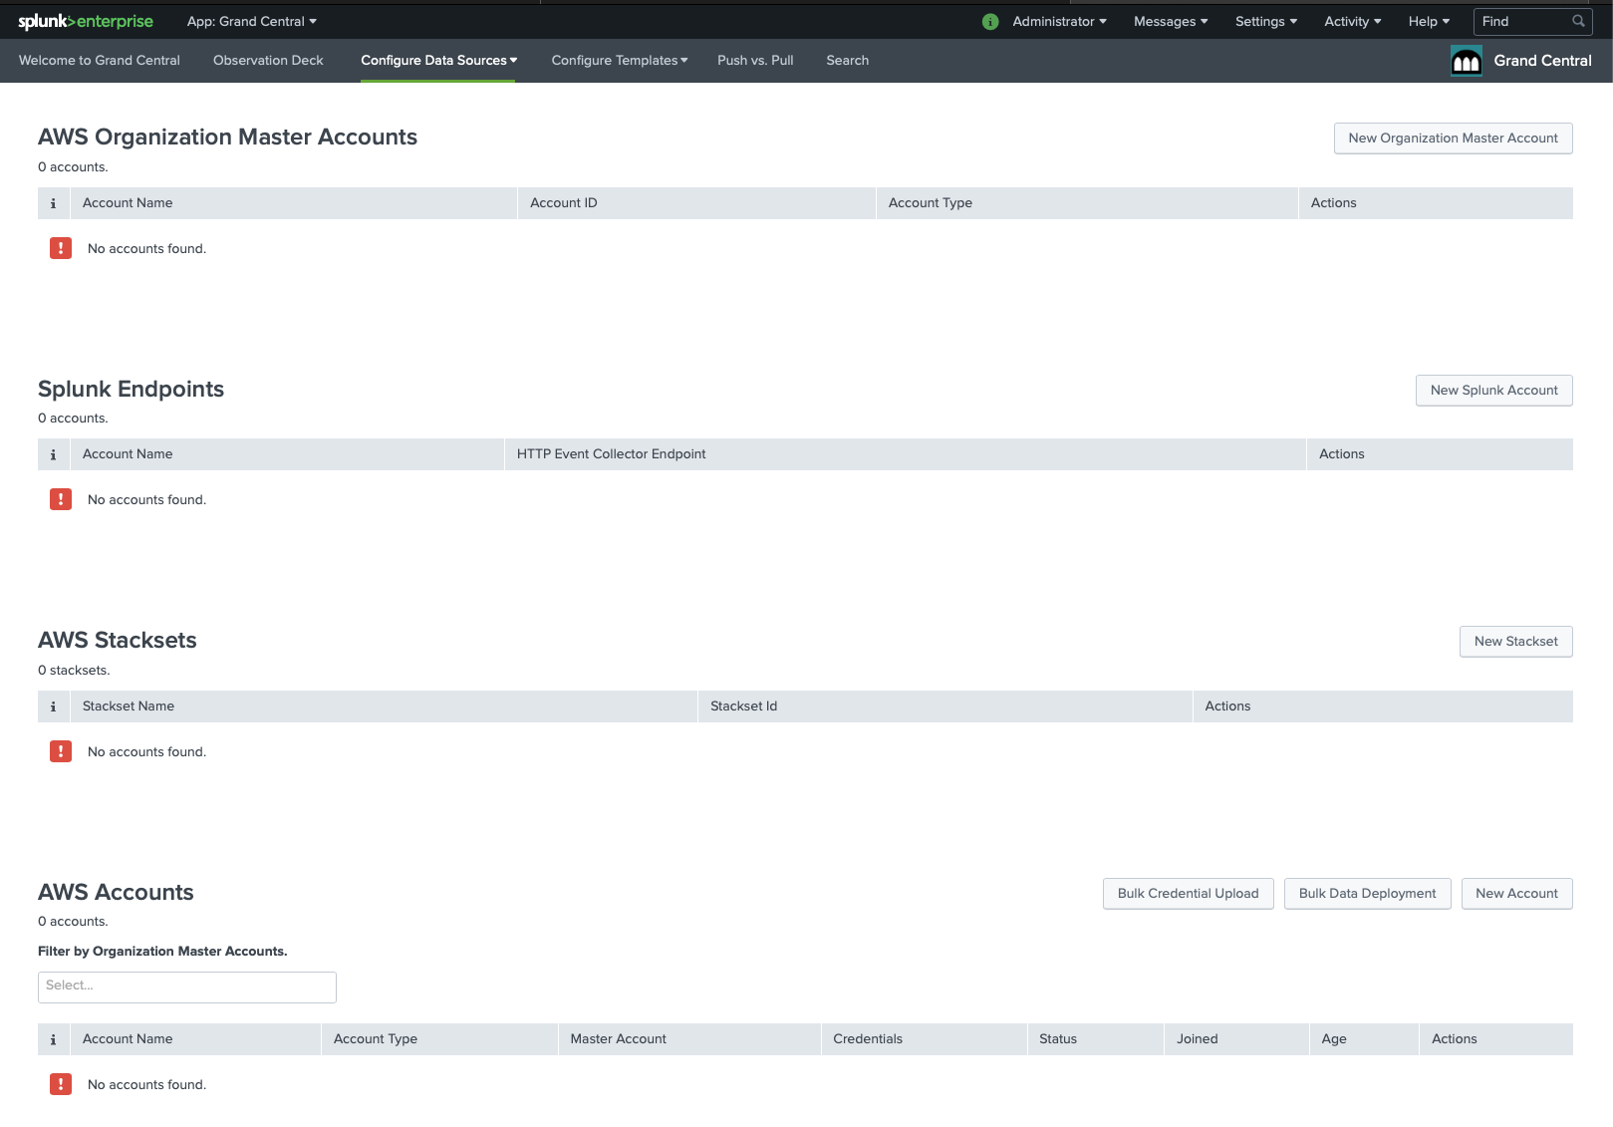
Configure Grand Central
Setup AWS Credentials 1 of 2
Click on New Account

Slide 20
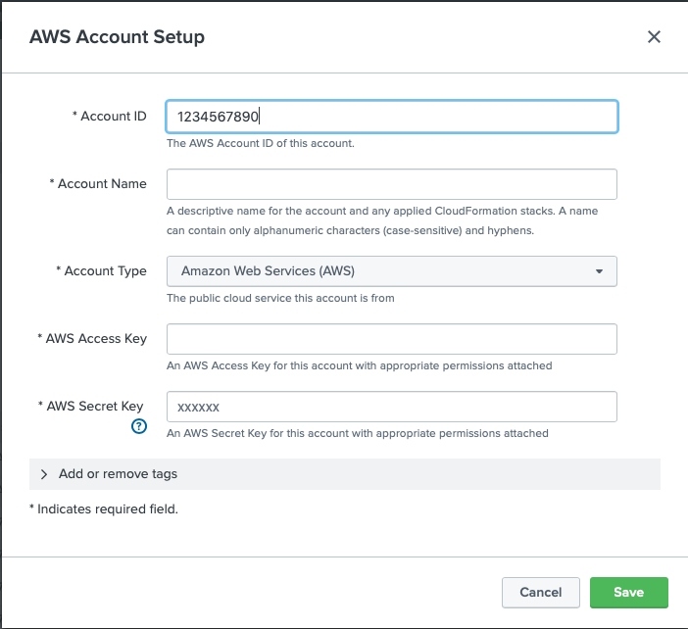
Configure Grand Central
Setup AWS Credentials 2 of 2
Enter AWS Account ID (Must be a number)
Account Name (e.g. Master AWS Account)
Add Access Key and Secret Key from credentials.csv file, accessKey.csv or CloudFormation output
Click Save

Slide 21
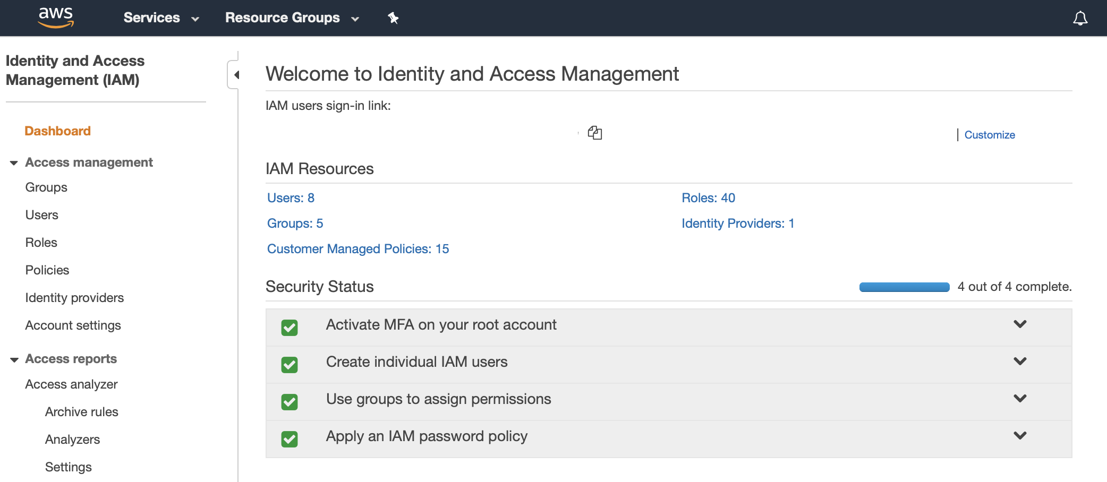
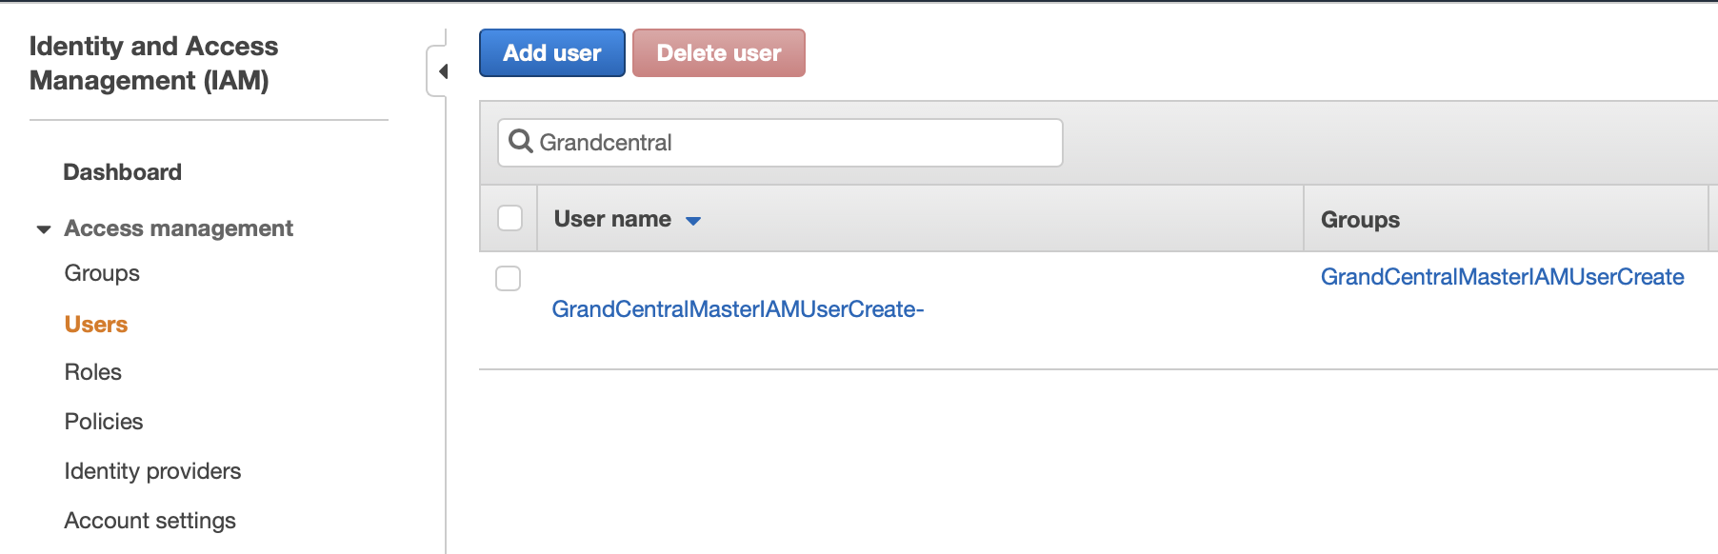
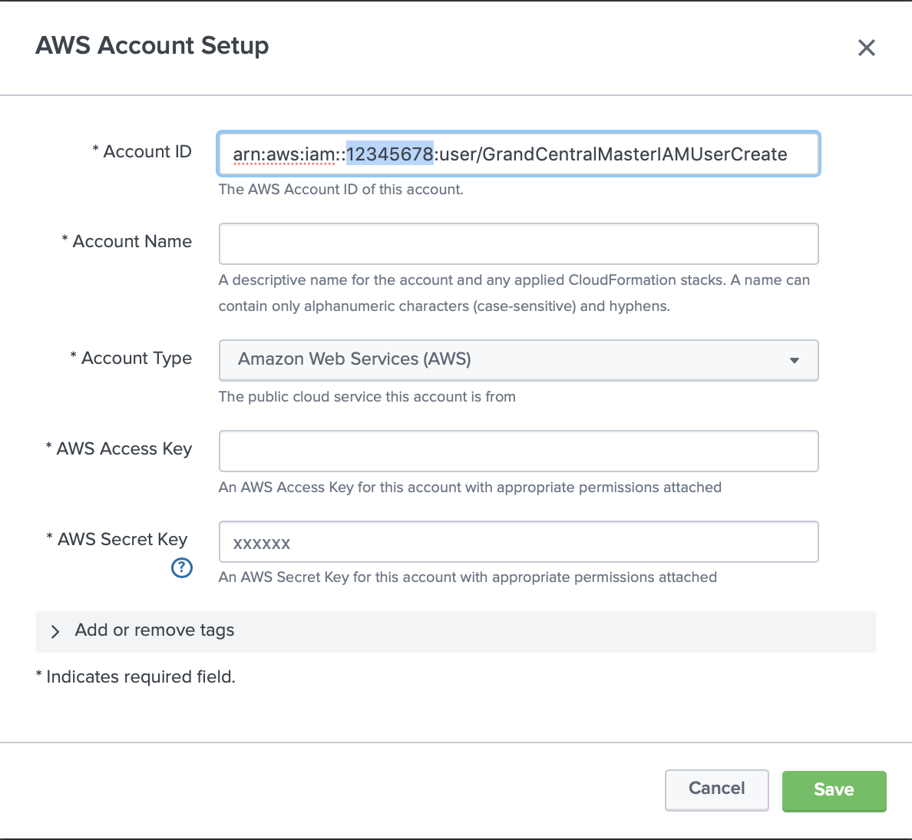
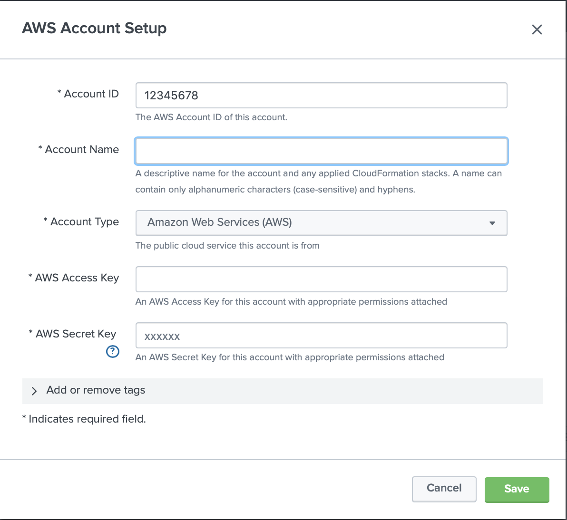
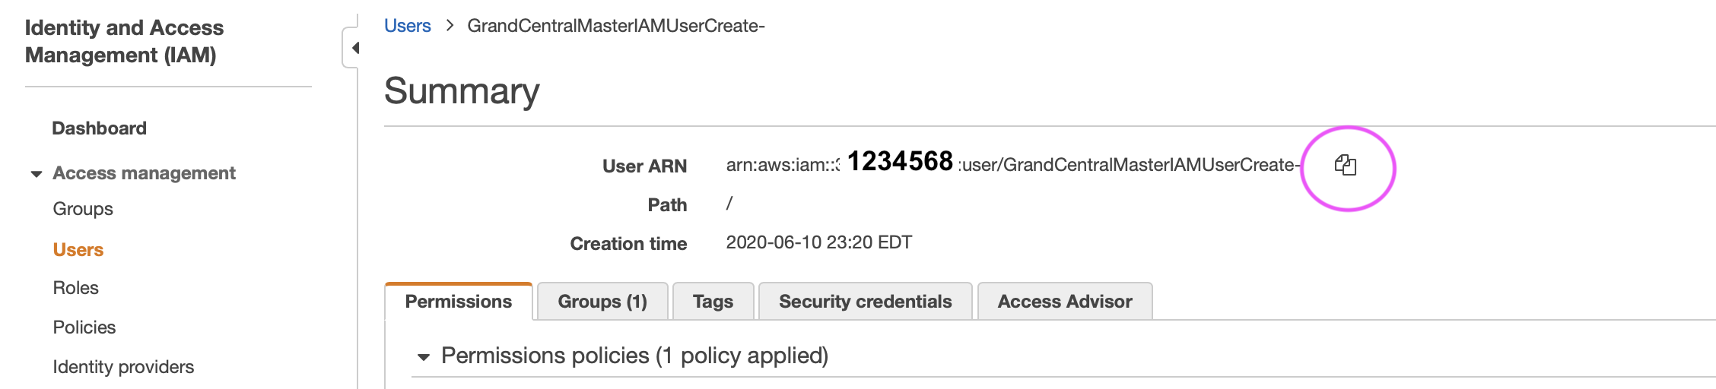
Pro Tip
Here is how you can get your AWS Account ID
1.
2.
1. Open IAM Service
2. Click on the Grand Central User
3 Copy the User ARN
4. Paste ARN and copy the Account Number
4.
3.

Slide 22
Configure Grand Central
Setup Splunk Account 1 of 2
Click on New Splunk Endpoint (formerly Account)

Slide 23
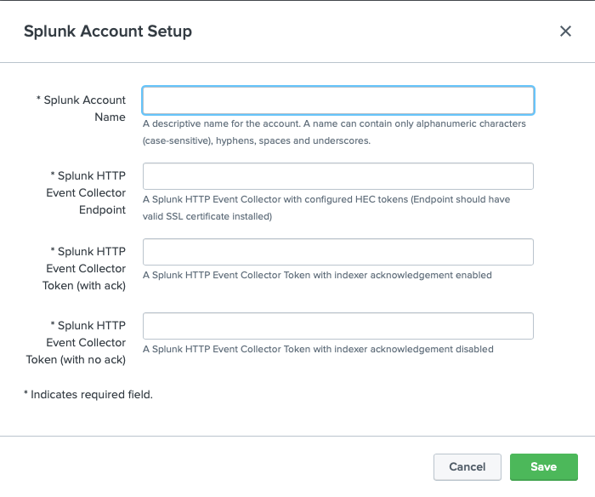
Configure Grand Central
Setup Splunk Account 2 of 2 (Repeat for each sourcetype)
Splunk Account Name (e.g. CloudTrail, Config, VPCFlow)
HTTP Endpoint must include port at the end:
Bootcamp
https://http-inputs-firehose-<bootcamp>.stg.splunkcloud.com:443
Production
https://http-inputs-firehose-<customer>.splunkcloud.com:443
Token for ACK and w/o ACK. (If only have on token, put in both spots).
Click Save

Slide 24
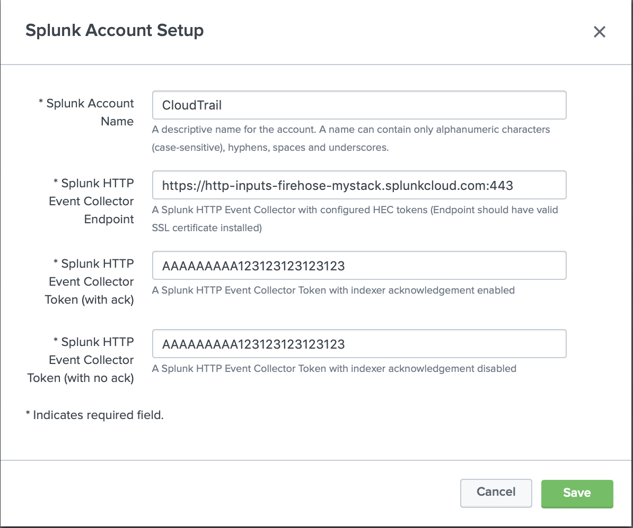
Configure Grand Central
EXAMPLE FORM FILLED OUT
Splunk Account Name = CloudTrail
HEC Endpoint = https://http-inputs-firehose-mystack.splunkcloud.com:443
Token for ACK and w/o ACK. (If only have on token, put in both spots).
Click Save

Slide 25
Deploy Data Collection

Slide 26
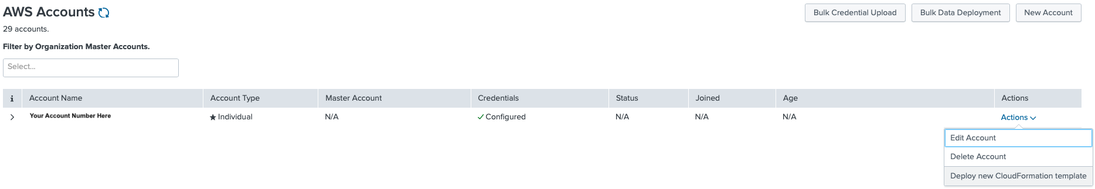
Deploy Data Collection
Click on Deploy new CloudFormation template in the account
Select Actions and Deploy new CloudFormation Template

Slide 27
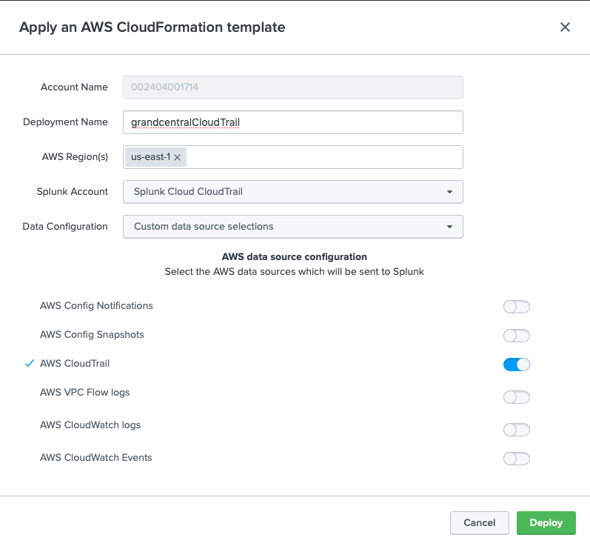
Deploy Data Collection
Rinse repeat for each sourcetype 1 of 3
Deploy Name – It must start with grandcentral, all lowercase all one word (e.g. grandcentralCloudTrail)
AWS Region(s) – Regions with workloads
Splunk Account – Splunk HEC endpoint
Data Configuration – Optional if using a custom Cloudformation Template
Select Data source - CloudTrail

Slide 28
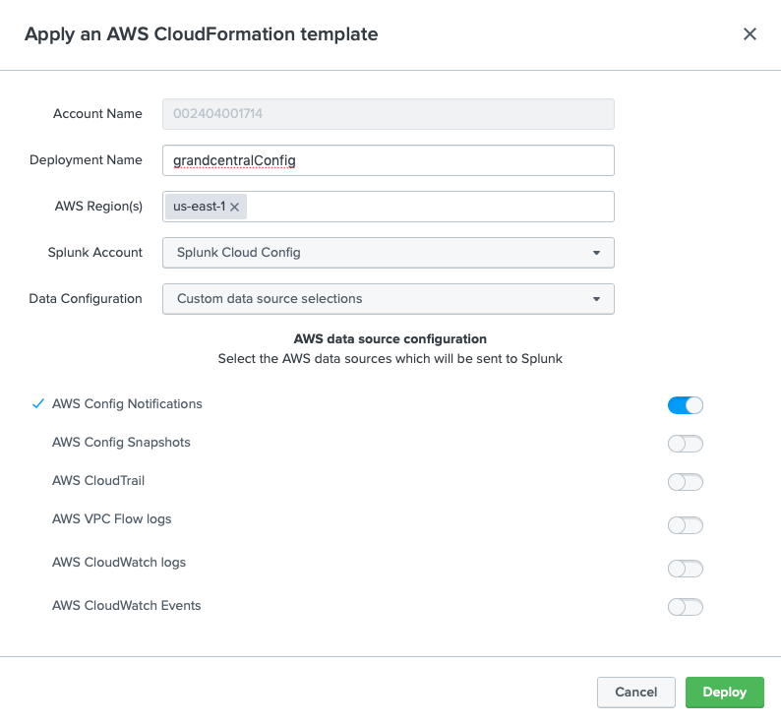
Deploy Data Collection
Rinse repeat for each sourcetype 2 of 3
Deploy Name – It must start with grandcentral, all lowercase all one word (e.g. grandcentralConfig)
AWS Region(s) – Regions with workloads
Splunk Account – Splunk HEC endpoint
Data Configuration – Optional if using a custom Cloudformation Template
Select Data source - Config

Slide 29
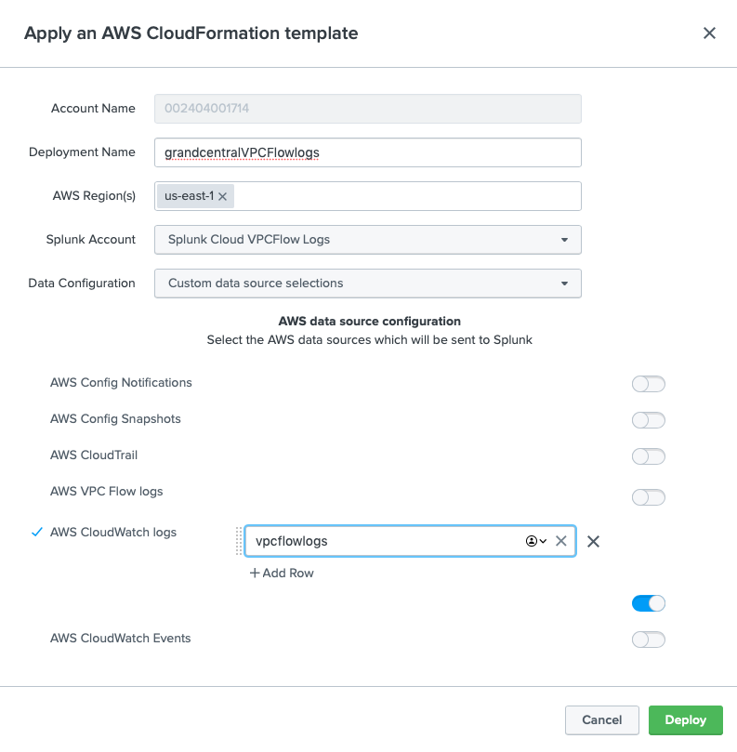
Deploy Data Collection
Rinse repeat for each sourcetype 3 of 3
Deploy Name – No spaces or special characters (e.g. grandcentralVPCFlowlogs)
AWS Region(s) – Regions with workloads
Splunk Account – Splunk HEC endpoint
Data Configuration – Optional if using a custom Cloudformation Template
Select Data source – AWS VPC Flow logs
CloudWatch Log Group : The name of the log group created earlier, e.g.

Slide 30
Delete Deployments

Slide 31
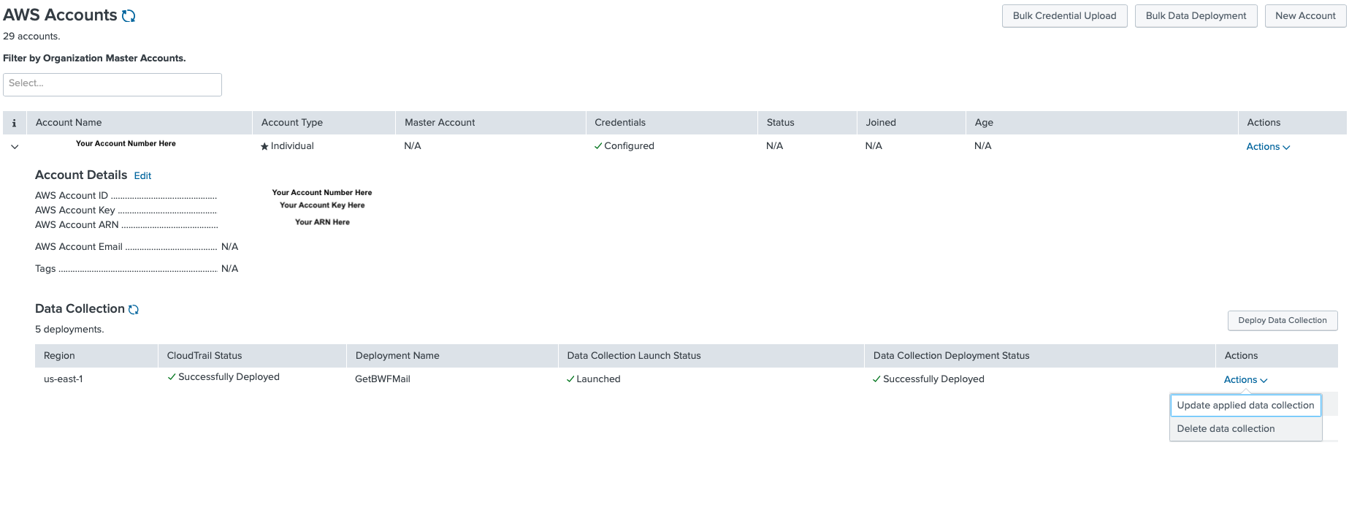
Delete Deployments
Don’t forget to remove your deployment
Click Here
to expand
Account
Click here and select Delete data collection.

Slide 32
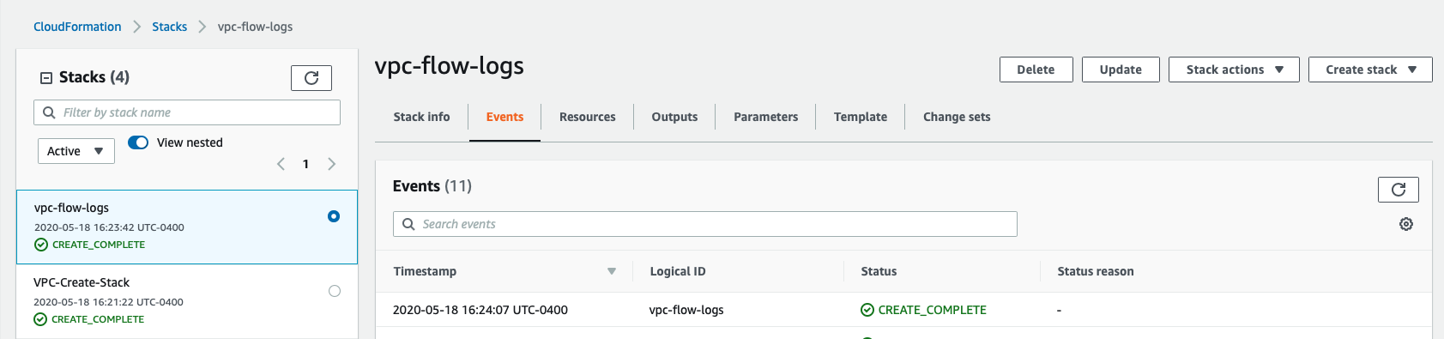
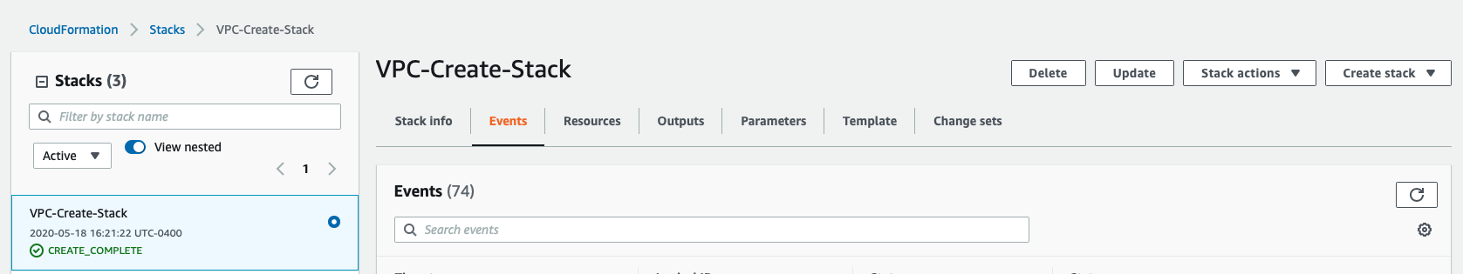
Burn Down
Here is how to burn down your VPC
Click Delete to your vpc-flow-logs Stack
Click Delete to your VPC-Create-Stack

Slide 34
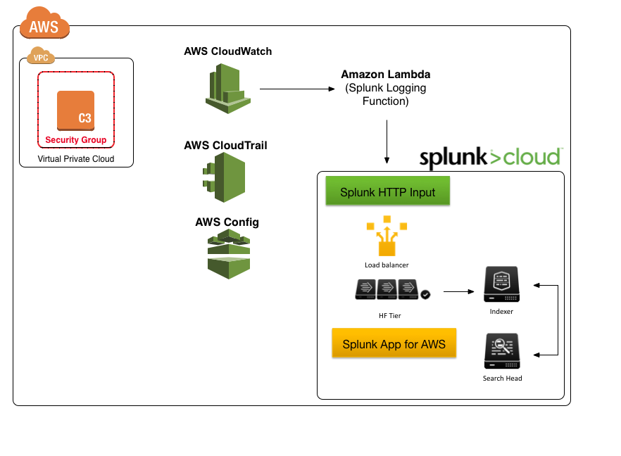
Setup AWS CloudWatch Logs
Setup VPC Flow Logs
Create CloudWatch Log Group (VPCFlowLogs)
Setup IAM User / Role VPC Flow permissions
Create VPC Flow Logs
Capture all data, no filter
Create flowlogRole policy
Notes:
Setting up CloudWatch Logs will start by creating the CloudWatch Log group, then opening the VPC service and pointing the Flow Logs to the newly created CloudWatch Log group. This will require that an IAM role be created that has access to write VPC Flow data to the CloudWatch Log Group. In the next module, we will setup a Lambda function to send the data into Splunk’s HTTP Event Collector (HEC).

Slide 35
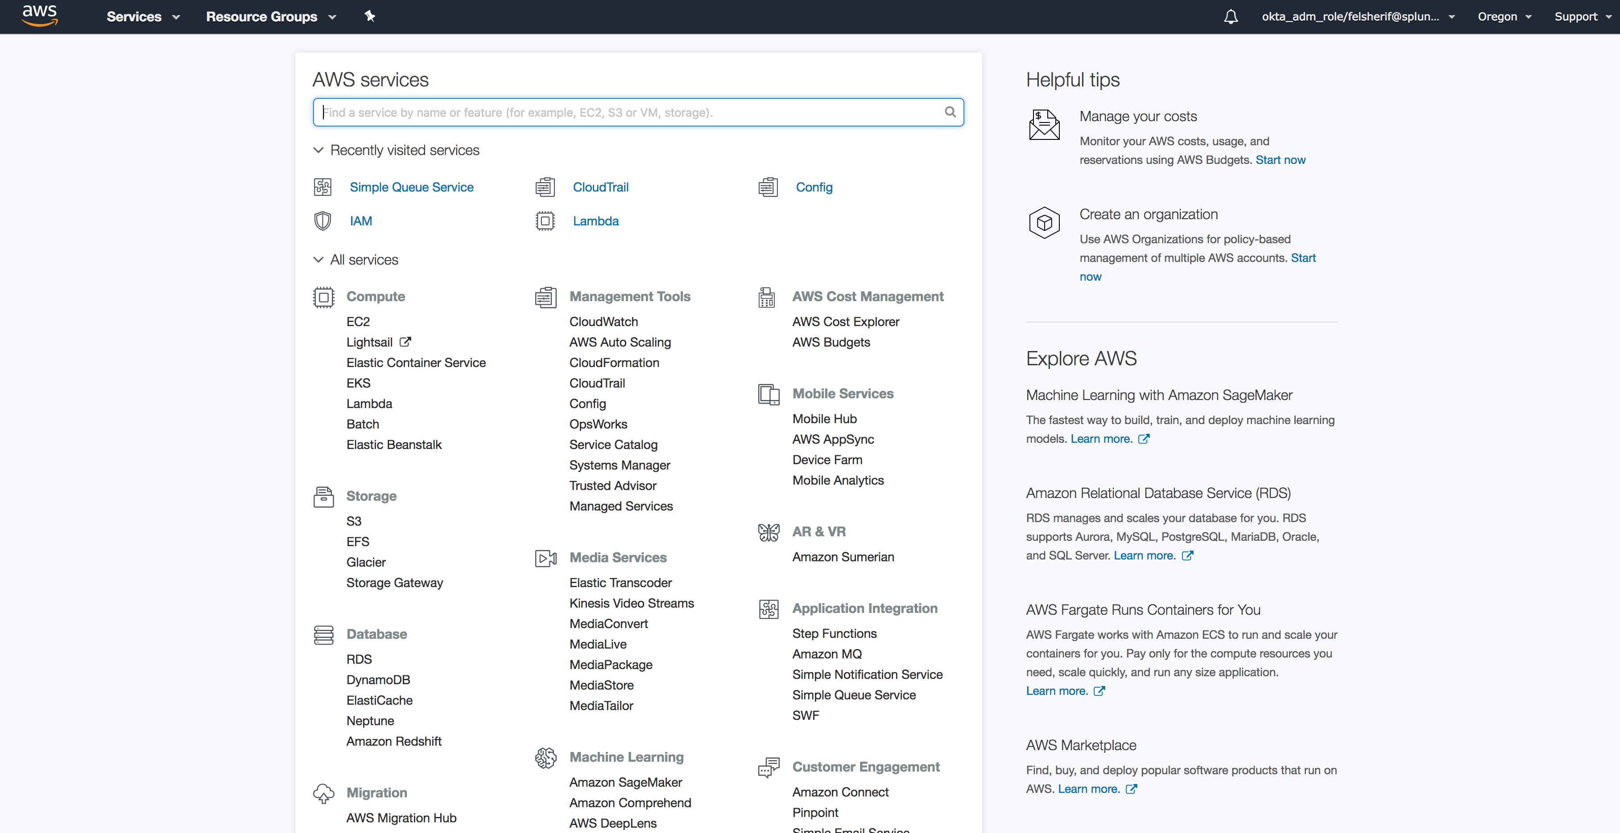
Setup AWS CloudWatch
Management Tools -> CloudWatch
Click Here
Notes:
Click on CloudWatch.

Slide 36
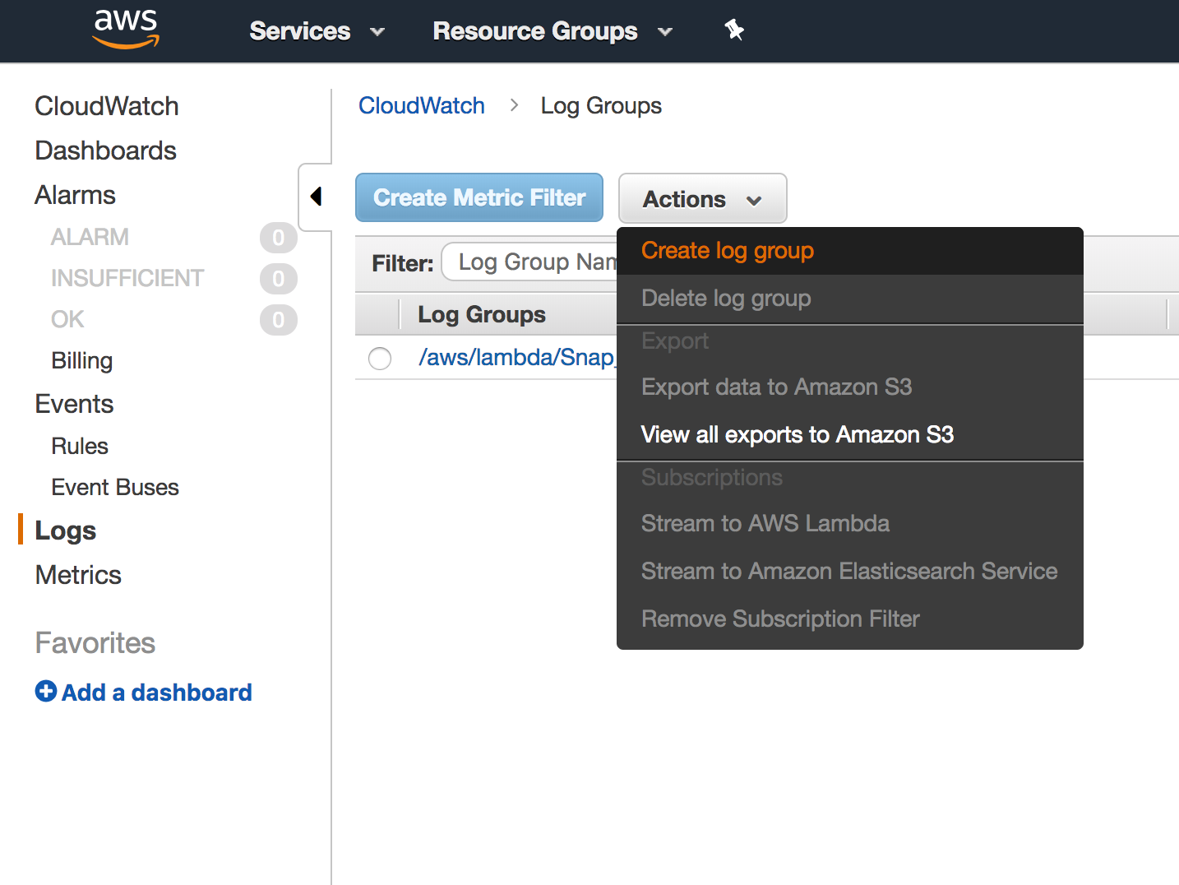
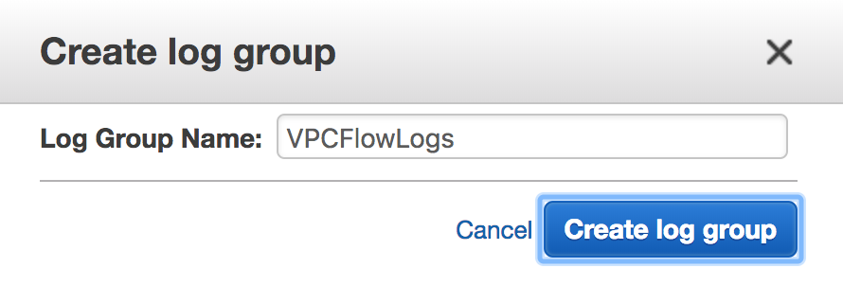
AWS CloudWatch Logs Setup
Create CloudWatch Log Group (VPCFlowLogs)
Notes:
Navigate to the Logs section on the left hand side. Click on Actions and “Create log group.” Give that log group a name, I suggest “VPCFlowLogs.”

Slide 37
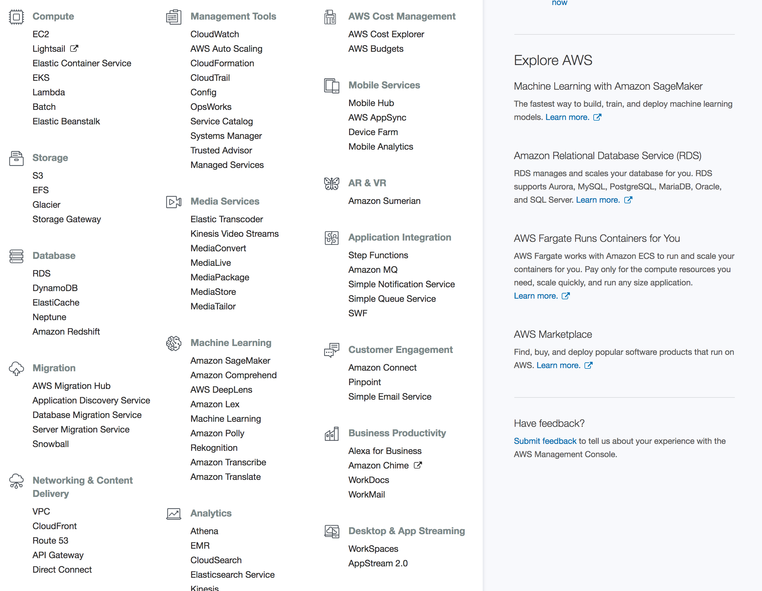
Go to the VPC Dashboard
Click Here
Notes:
Now, let’s go into VPC and enable the Flow logs to send data to that CloudWatch Log group. Click on VPC under Networking and Content Delivery.

Slide 38
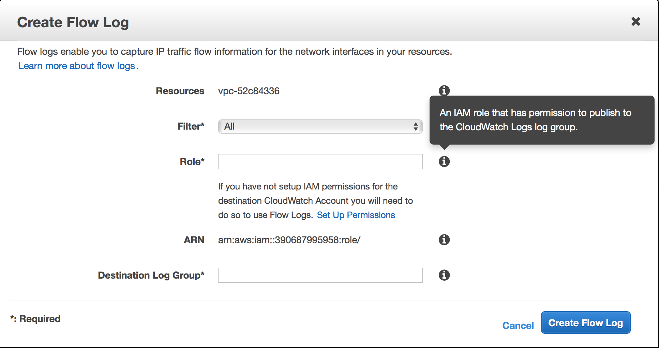
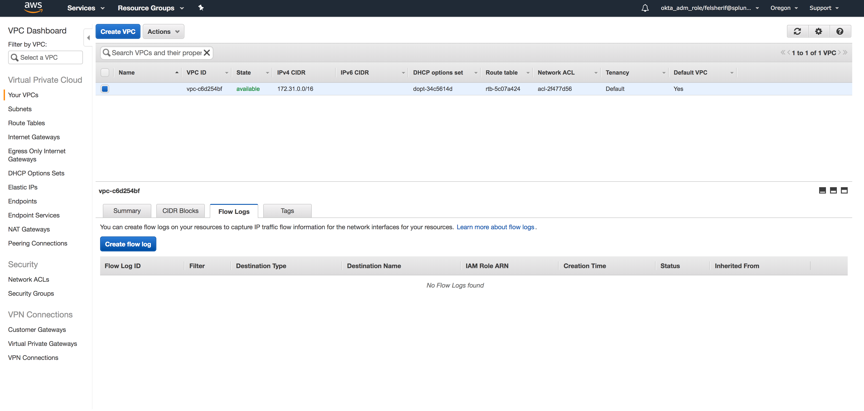
AWS CloudWatch Logs Setup
Select your VPC
Create VPC Flog Logs
Click Here
Click on “Set Up Permissions”
Notes:
Select your VPC, if you have multiple, just follow this step for each one. Once you have your VPC Selected, click on the “Flow Logs” tab and click “Create Flow Log.” This will prompt a wizard for setting up your VPC Flow logs. Under filter, select All. Now, continue to the next slide, DO NOT CLICK on Create Flow Log yet!

Slide 39
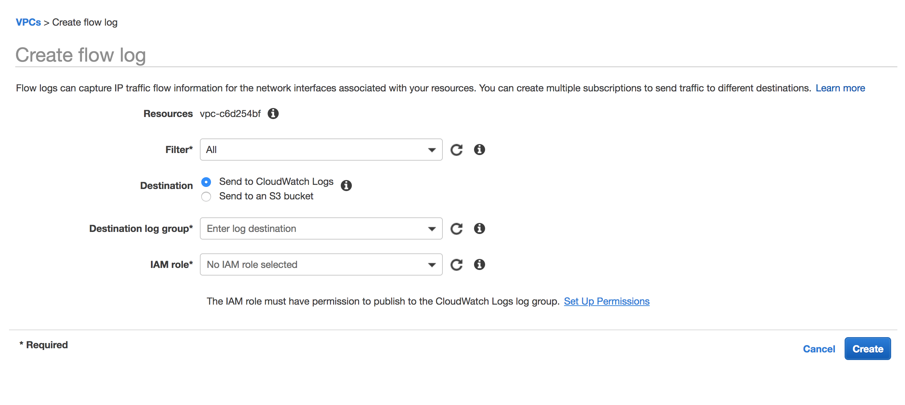
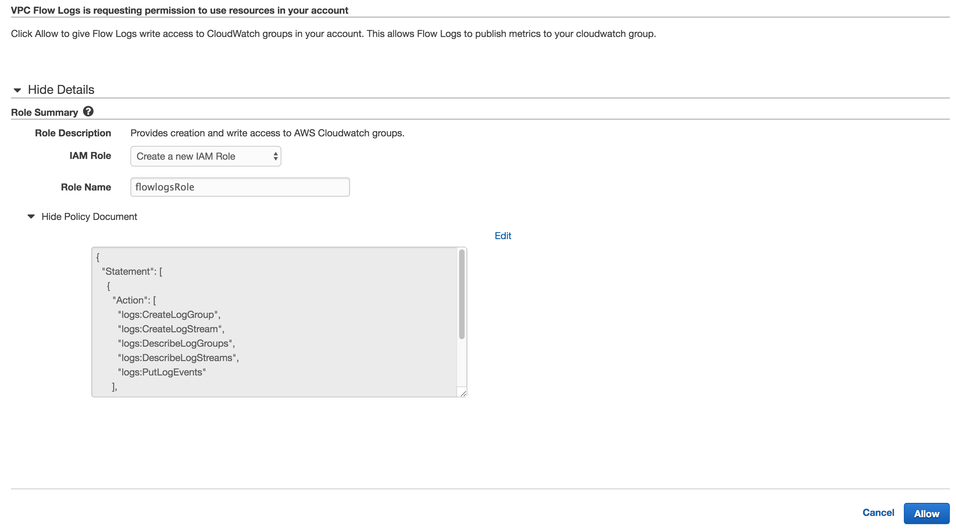
AWS CloudWatch Logs Setup
Create the default policy ‘flowlogsRole’
Click on “Set Up Permissions” and create default VPC Flow Role “flowlogsRole”
The Policy editor will pop-up, click allow and it will create the default role “flowlogsRole” and click Allow
Notes:
If this is the first time you are creating a VPC Flow Log, make sure you click on “Set Up Permissions,” since you probably DO NOT have a role to collect the VPC Flow data. This will go to a new tab where a new role ‘flowlogsRole’ will be automatically created. Click on Allow a the bottom right hand side of the screen. Continue to the next slide.

Slide 40
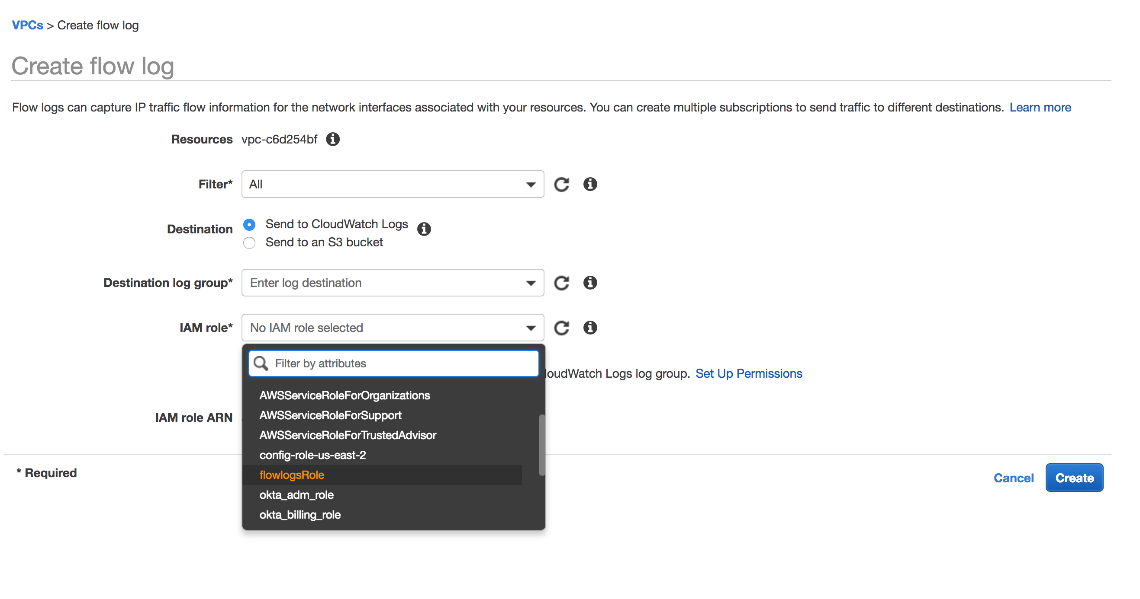
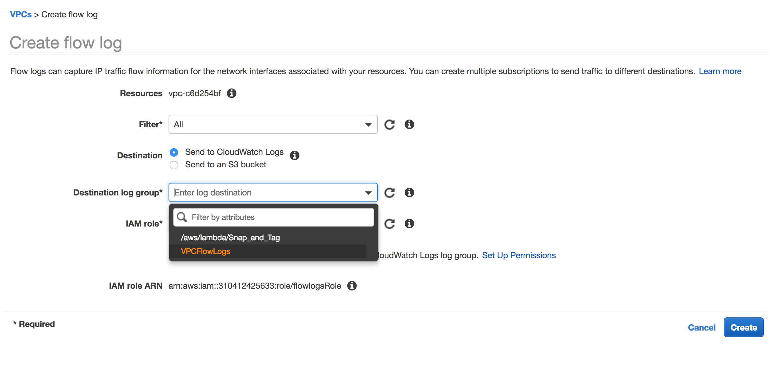
AWS CloudWatch Logs Setup
Select CloudWatch Log Group, VPCFlowLogs
Select “flowlogsRole”
Select the CloudWatch Log group VPCFlowLogs.
Click Create Flow Log
Notes:
You should now see the newly created role, flowlogsRole, in the dropdown; select that role and then select the Destination Log Group VPCFlowLogs (the one we just created in the CloudWatch Logs step.) Now click on “Create Flow Log.”

Slide 41
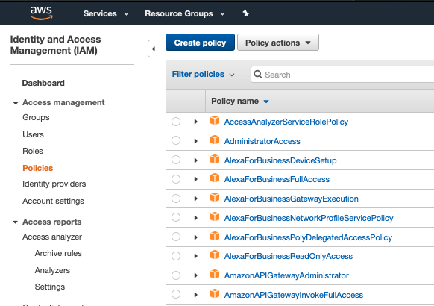
Create AWS Account (Credential File)
AWS Console - > IAM -> Create Policy
Create Policy
Go to IAM
Click on Policies
Click Create Policy

Slide 42
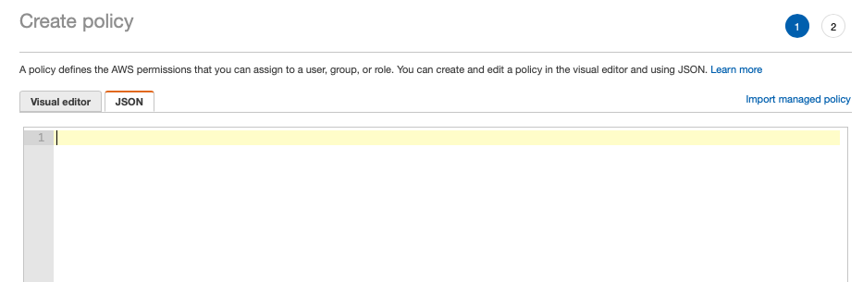
Create AWS Account (Credential File)
AWS Console - > Create Policy (JSON)
Click on the JSON tab
Clear out all the existing policy

Slide 43
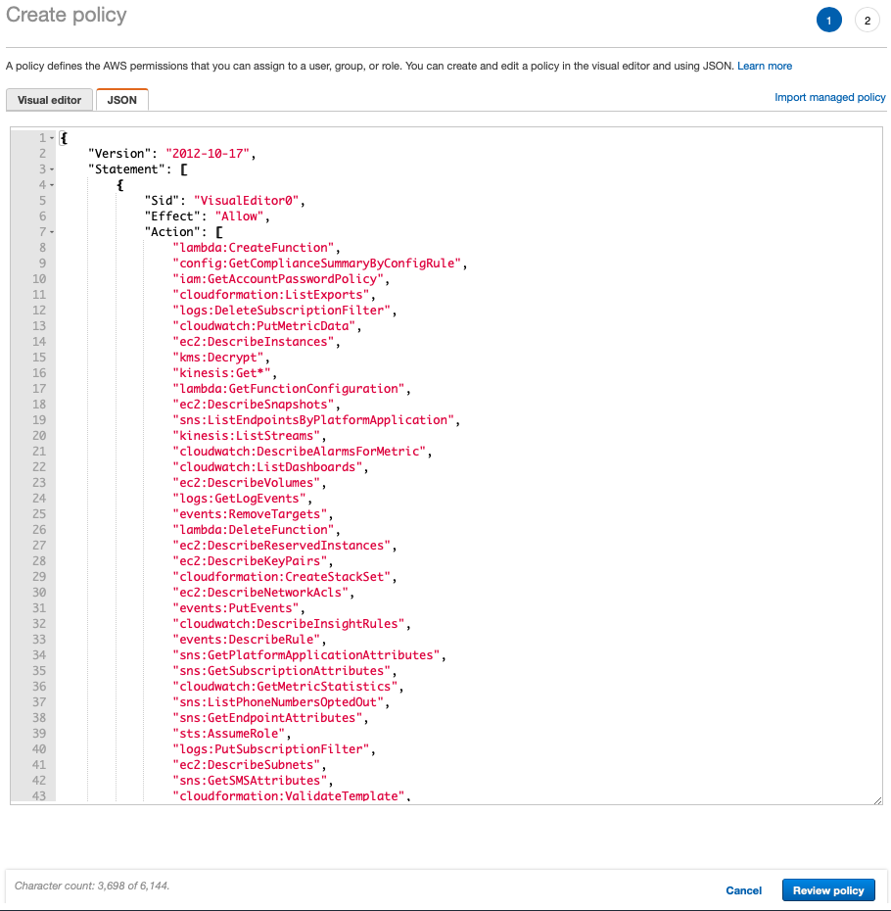
Create AWS Account (Credential File)
AWS Console - > Create Policy (JSON)
Copy the policy from here
Paste the policy here
Click Review Policy

Slide 44
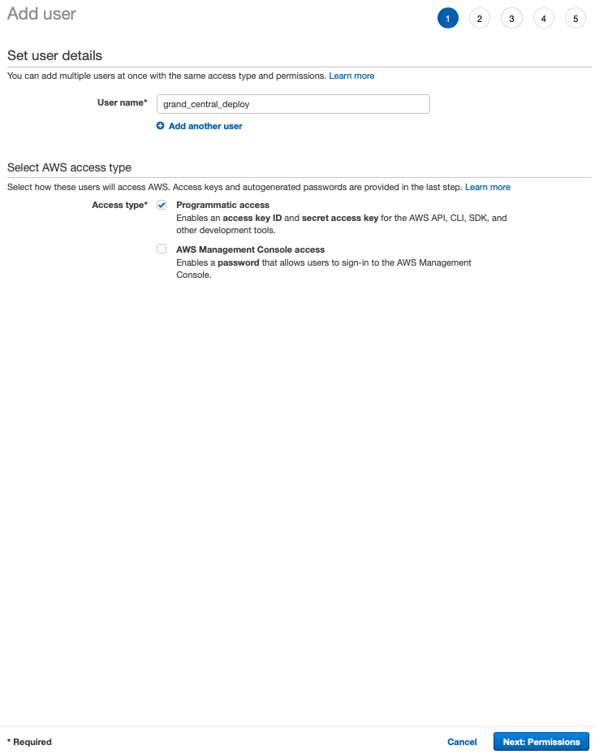
Create AWS Account (Credential File)
AWS Console - > Create User
Create User : grand_central_deploy
Programmatic access checked
Click Next : Permissions

Slide 45
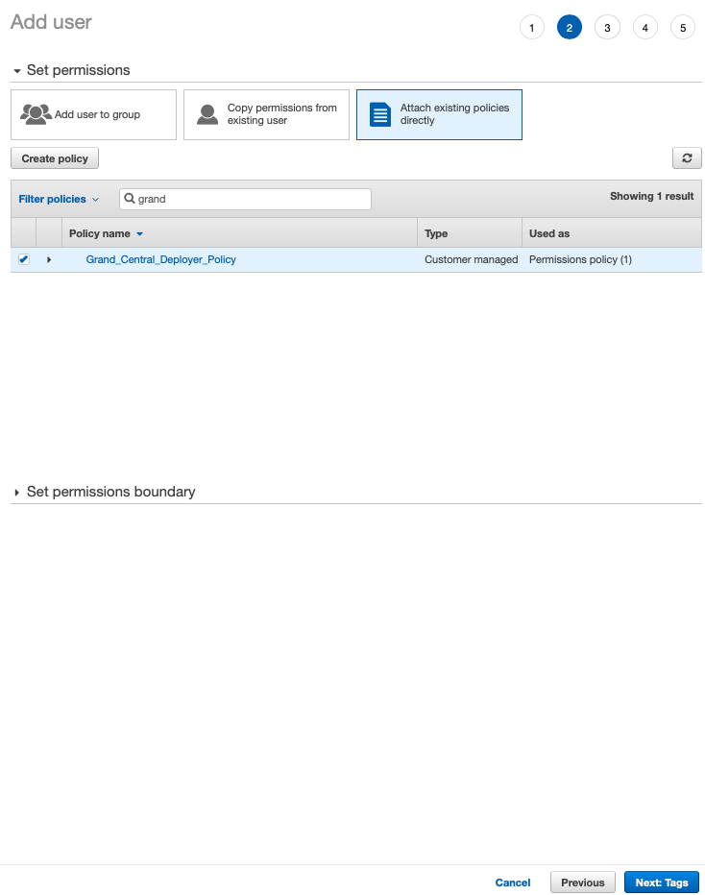
Create AWS Account (Credential File)
AWS Console - > Set Permissions
Select Attach policies directly
Search for “Grand_Central…” policy
Click the check box
Click Next : Tags

Slide 46
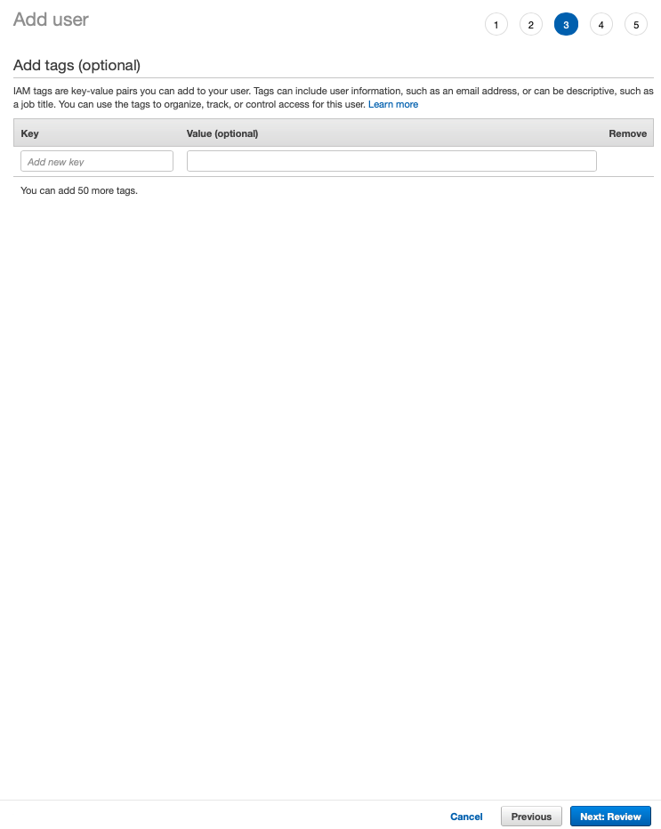
Create AWS Account (Credential File)
AWS Console - > Skip Tags
Skip adding tags
Click Next : Review

Slide 47
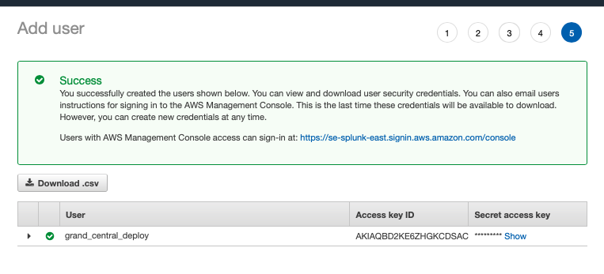
Create AWS Account (Credential File)
AWS Console - > Review
Click Download .csv
Save the credentials.csv

